Slide 1



CREDIT CARD FRAUD DETECTION
Presented By
Pushpendra Singh & Viraj Bhadra

Slide 2
Abstract
In today's digital era, financial institutions face a significant challenge in detecting and preventing credit card fraud efficiently. To address this challenge, we have developed a sophisticated Flask application integrated with a machine learning model tailored for real-time credit card fraud detection. The application's user-friendly interface empowers users to input transaction details, enabling the system to generate accurate fraud predictions promptly. By leveraging advanced algorithms and seamless technology integration, our project aims to enhance proactive risk management in financial transactions. Through meticulous design and implementation, we strive to provide a comprehensive solution that improves efficiency, usability, and effectiveness in fraud detection systems, thereby safeguarding financial integrity and customer trust.

Slide 3
Acknowledgement
I would like to convey my heartfelt gratitude to Dr. Dipika Vishe for her tremendous direction and assistance in the completion of my project. I am eternally grateful to you.
I am deeply indebted to Head of Computer Department Ms. Madhuri Narkhede and our Principal Dr. Seema Pillai for giving us this valuable opportunity to do this project.
I am thankful to our college Smt. Devkiba Mohansinhji Chauhan College of Commerce and Science for considering our project and extending help at all stages needed during our work of collecting information regarding this project. I’d also like to thank my friends and parents for their support and encouragement as I worked on this assignment.

Slide 4

INTRODUCTION
WELCOME TO OUR CREDIT CARD FRAUD DETECTION PROJECT! WE'VE DEVELOPED A ROBUST FRAUD DETECTION MODEL USING ADVANCED MACHINE LEARNING TECHNIQUES LIKE LOGISTIC REGRESSION, DECISION TREES, AND RANDOM FORESTS. OUR MODEL ADDRESSES DATASET IMBALANCES THROUGH UNDERSAMPLING AND OVERSAMPLING METHODS. EXPLORE OUR WEBPAGE FOR INSIGHTS INTO MODEL PERFORMANCE AND ANALYSIS RESULTS.

Slide 5
Problem Statement
Design and develop a Flask application integrated with a machine learning model to address the challenge of credit card fraud detection in real-time. The goal is to create a user-friendly interface that allows users to input transaction details and receive accurate fraud predictions, enhancing proactive risk management in financial transactions.

Slide 6


OBJECTIVES
THE FIRST OBJECTIVE
THE SECOND OBJECTIVE
THE THIRD OBJECTIVE
Model Development and Optimization
Addressing Class Imbalance
Performance Evaluation and User Interface

Slide 7


REVIEW OF LITERATURE
Sources:
FRAUDULENT FINANCIAL TRANSACTIONS DETECTION USING MACHINE LEARNING
FRAUD DETECTION USING NEURAL NETWORKS: A CASE STUDY OF INCOME TAX
FINANCIAL FRAUD DETECTION BASED ON MACHINE LEARNING: A SYSTEMATIC LITERATURE REVIEW

Slide 8

AN EFFICIENT TECHNIQUES FOR FRAUDULENT DETECTION IN CREDIT CARD DATASET: A COMPREHENSIVE STUDY
REVIEW OF LITERATURE
CREDIT CARD FRAUD DETECTION USING MACHINE LEARNING BY MEERA ALEMAD
FRAUD DETECTION USING MACHINE LEARNING ADITYA OZA

Slide 9
RESEARCH METHODOLOGY
Data Collection and
Preparation
Handling Imbalanced
Data
Model Training
and Evaluation
Interpretation and
Documentation
Iterative Optimization

Slide 10
RESULTS
After Undersampling
Models | Accuracy | Precision | Recall | F1 Score
Logistic Regression | 93.684211 | 96.875 | 91.176471 | 93.939394
Decision Tree Classifier | 90.000000 | 89.52381 | 92.156863 | 90.821256
Random Forest Classifier | 93.157895 | 96.842105 | 90.196078 | 93.401015

Slide 11
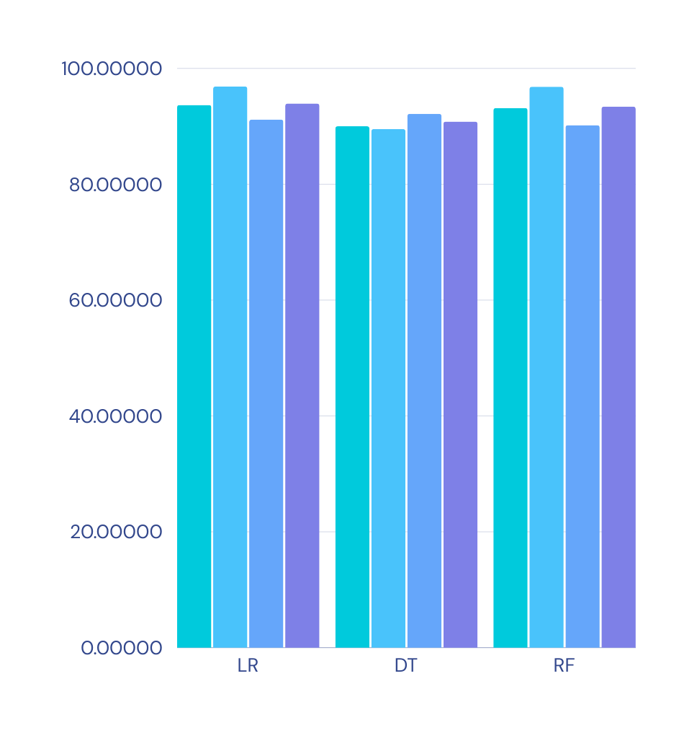
RESULTS
PROJECT FINDINGS FROM RESEARCH METHODOLOGY
Results after undersampling the data and checking accuracy, precision, recall, f1

Slide 12
RESULTS
After Undersampling
Models | Accuracy | Precision | Recall | F1 Score
Logistic Regression | 94.385697 | 97.332041 | 91.265931 | 94.201430
Decision Tree Classifier | 99.798321 | 99.729479 | 99.867280 | 99.798332
Random Forest Classifier | 99.991824 | 99.983640 | 100.000000 | 99.991819

Slide 13
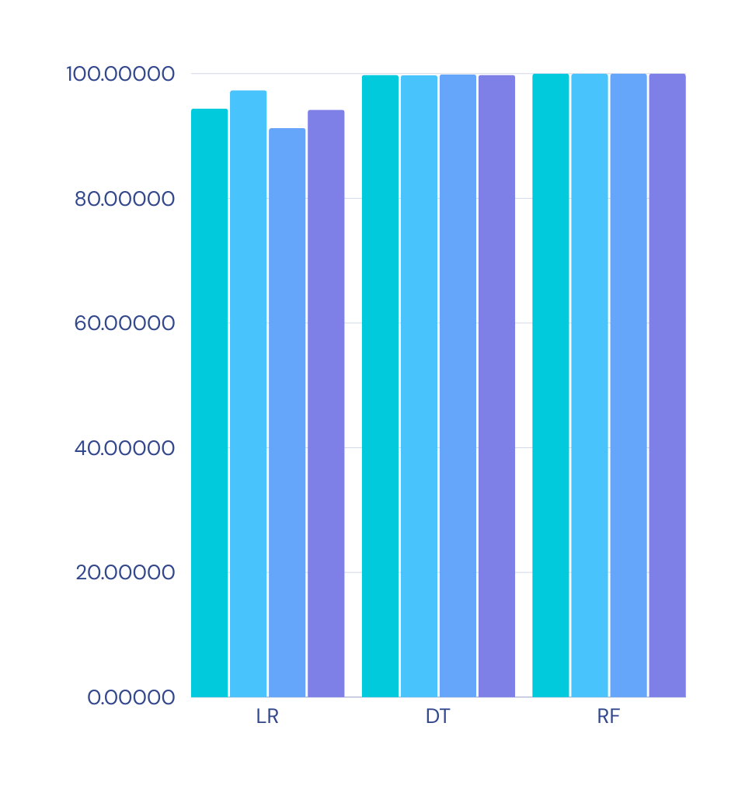
RESULTS
PROJECT FINDINGS FROM RESEARCH METHODOLOGY
Results after oversampling the data and checking accuracy, precision, recall, f1

Slide 14
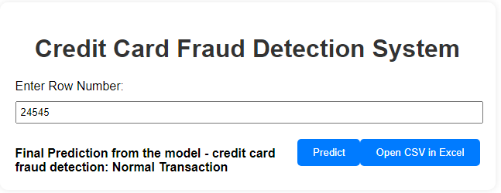
RESULTS
PROJECT FINDINGS FROM QUANTITATIVE METHODOLOGY
The Flask app efficiently predicts fraud for specified transaction rows, offering real-time insights into credit card fraud detection through a user-friendly interface.

Slide 15
Future Enhancements
Advanced Machine Learning Techniques
Real Time Data Streaming
Automated Model Retraining
Enhanced User Authentication
Compliance and Regulatory Features

Slide 16


CONCLUSION
IN CONCLUSION, OUR STREAMLINED FLASK APPLICATION EMPOWERS USERS WITH REAL-TIME FRAUD PREDICTION CAPABILITIES, BRIDGING MACHINE LEARNING INSIGHTS AND USER-FRIENDLY INTERFACE DESIGN FOR PROACTIVE CREDIT CARD FRAUD DETECTION AND RISK MITIGATION.

Slide 17

REFERENCES
FINANCIAL FRAUD DETECTION BASED ON MACHINE LEARNING: A SYSTEMATIC LITERATURE REVIEW
AN EFFICIENT TECHNIQUES FOR FRAUDULENT DETECTION IN CREDIT CARD DATASET: A COMPREHENSIVE STUDY
01
04
FRAUDULENT FINANCIAL TRANSACTIONS DETECTION USING MACHINE LEARNING
CREDIT CARD FRAUD DETECTION USING MACHINE LEARNING BY MEERA ALEMAD
02
05
FRAUD DETECTION USING NEURAL NETWORKS: A CASE STUDY OF INCOME TAX
03

Slide 18
Thank You

